Slide 1
Title
Team # 3
Team Member Name
3/12/2025
Notes:
We will do the part of using quaternion transformer to do the financial sentimental analysis.

Slide 2
Summary
Goal: Evaluate the performance of LLM & Quanternion Model Based on Financial Sentimental Text Background
Query
Train/Test Dataset
Financial Sentimental Text
LLM Model (open llama 3b)
Prediction
Result Visualization
Quaternion Transformer
Classificaiton
Team Project
Notes:
This is our workflow.
We collected train/test dataset of sentimental text using spark and other big data tools; and divide them into three types: positive, negative, neutral.
And then we train the LLM model and Quaternion Transformer separately to do the prediction.
LLM Model is based on predict the label output and quaternion transformer model is classification.

Slide 3
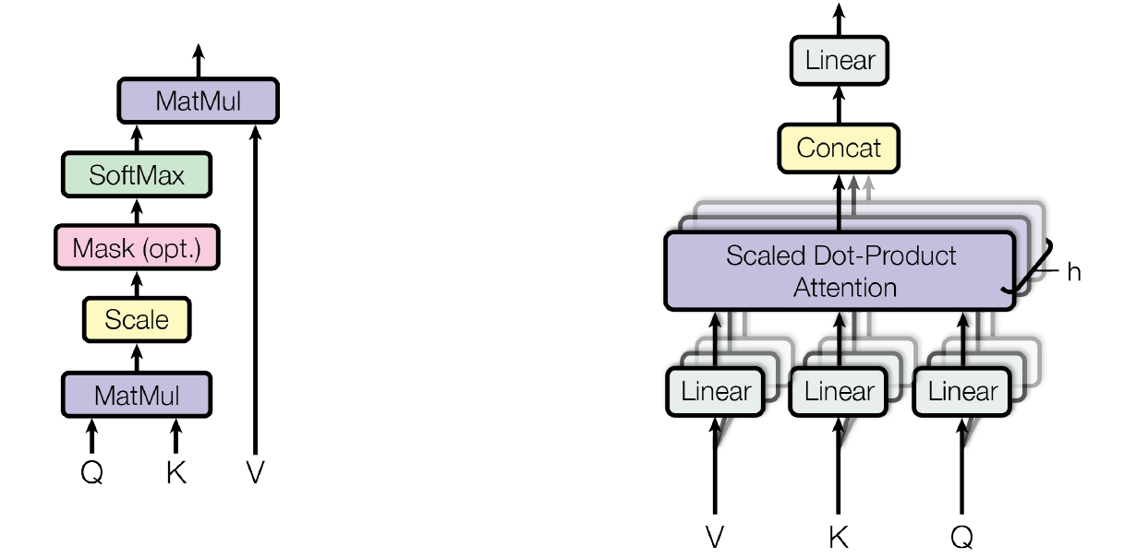
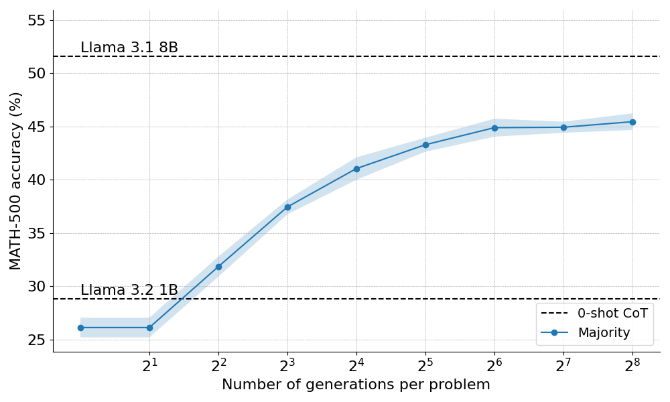
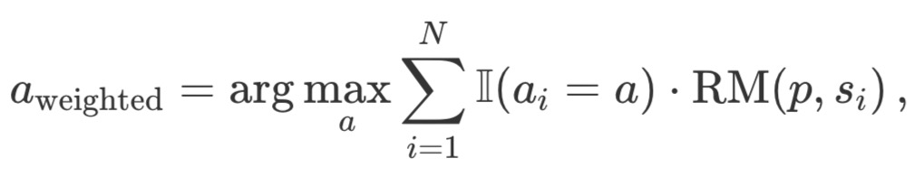
Benchmark Model
Our Model is Open Llama 3b Model (Meta AI)
Parameter Size: 3.437 B; Traning Time: ~40 min
Mechanism: Predict the following label text by giving a single sentence, and then classify it into positive negative/neutral
Example: $AAPL weekly still under the 50 moving average and creating a lower high. (Negative)
Accuracy: 71.34%
Notes:
This slide describes a machine learning model based on the Open LLaMA 3B model developed by Meta AI. Here’s a breakdown of the key points:Model: The base model used is Open LLaMA 3B, a 3.437 billion parameter transformer model.Training Time: The fine-tuning process took approximately 40 minutes.Mechanism:The model takes a single sentence as input.It predicts the sentiment label of the sentence.The classification output can be positive, negative, or neutral.Example:Input: "AAPL weekly still under the 50 moving average and creating a lower high."Output: Negative sentiment (since the statement implies a bearish outlook on Apple’s stock price).This suggests that the model is fine-tuned for sentiment analysis, likely in financial or stock market-related contexts.

Slide 4
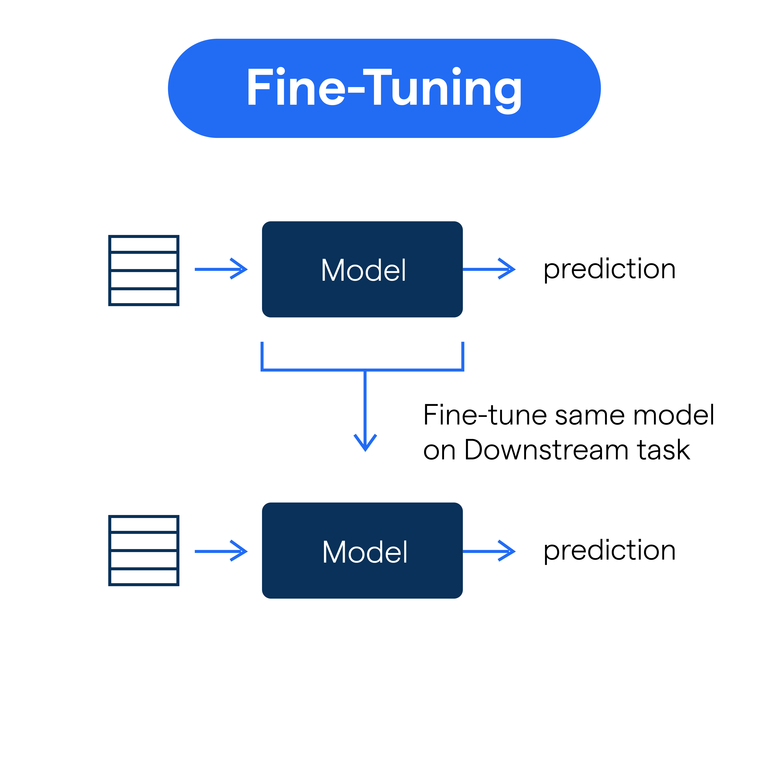
Finetune in LLM Model
Full Fine-Tuning: Adjust all model weights (more resource-intensive).
Feature Extraction: Freeze some layers and update only the final layers.
Adapter Layers / LoRA (Low-Rank Adaptation): Train additional small modules while keeping most weights frozen.
Prompt Tuning: Modifying input prompts instead of model parameters.
Notes:
. Full Fine-TuningMethod: Train and update all model parameters.Characteristics:Requires significant computational resources and storage.Suitable for scenarios with large datasets and high task-specific requirements (e.g., training a dedicated AI assistant).May lead to catastrophic forgetting (overfitting to the new task while losing knowledge from pre-training).Use Case: When the target task differs significantly from the pre-training task and sufficient compute power is available.2. Feature ExtractionMethod: Freeze most layers of the transformer model and only train the last few layers.Characteristics:Reduces computational cost compared to full fine-tuning.Preserves general language knowledge from pre-training.Can be effective for tasks that require domain-specific adaptation while retaining pre-trained features.Use Case: When the pre-trained model already captures useful representations and only minor task-specific tuning is needed.3. Adapter Layers / LoRA (Low-Rank Adaptation)Method: Introduce small trainable modules (adapters or LoRA layers) within the frozen model layers while keeping most parameters unchanged.Characteristics:Highly efficient—only a fraction of the parameters are updated.Helps prevent overfitting and reduces memory requirements.Often used in multi-task learning and resource-constrained environments.Use Case: Ideal for training a model on multiple specialized tasks with minimal computational overhead.4. Prompt TuningMethod: Instead of modifying the model parameters, modify the input prompts to guide the model’s behavior.Characteristics:Lightweight—does not require updating model weights.Uses learnable prompts that are optimized for specific tasks.Works well for large-scale pre-trained models where traditional fine-tuning is costly.Use Case: When compute resources are limited, and the model needs to generalize across different tasks without direct parameter tuning.

Slide 5
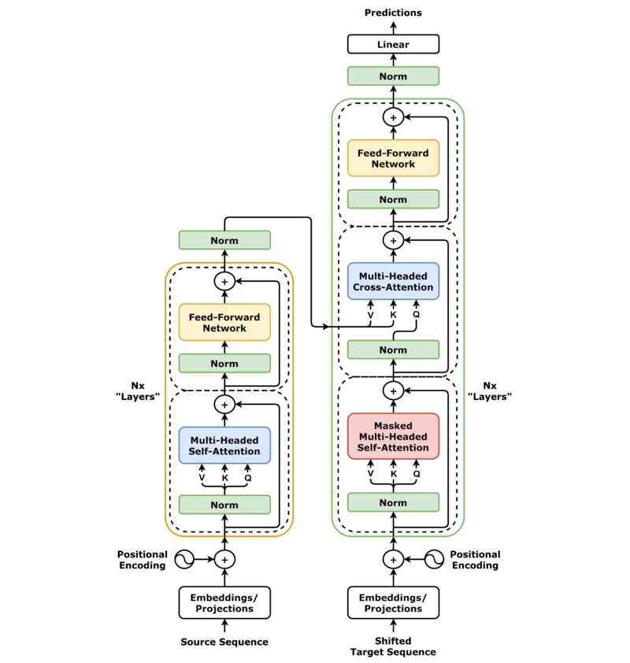
Quaternion Transformer Model
Partial vs Full: The feed-forward (linear) layers are replaced with QFFNs in a “full” transformer
Dealing with real inputs: Simply treat sequences of 4 as the 4 components of a quaternion
Dealing with output: Simply treat the 4 components of a quaternion as a regular series of real values
Parameter Size: 8.5 M; Traning Time: ~10 min
Accuracy: 66.84%
Notes:
This slide discusses a quaternion-based transformer model and compares partial vs. full transformer architectures. Here's a breakdown:Partial vs. Full Transformer:In a full transformer, the feed-forward (linear) layers are replaced with Quaternion Feed-Forward Networks (QFFNs) instead of traditional real-valued layers.This suggests the model uses quaternion algebra, which can reduce the number of parameters while maintaining performance.Handling Real Inputs:The model processes real-valued input sequences by grouping them into sets of four, treating them as the four components of a quaternion (a mathematical structure extending complex numbers).Handling Outputs:After processing, the model interprets the four quaternion components as a standard sequence of real values, making them compatible with traditional architectures.Model Specifications:Parameter Size: 8.5 million parameters (suggesting a lightweight model).Training Time: ~10 minutes (indicating efficiency).Accuracy: 66.84%, which suggests moderate performance, likely on a classification or prediction task.

Slide 6
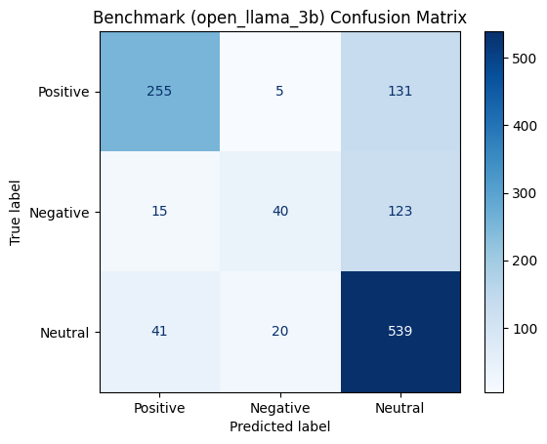
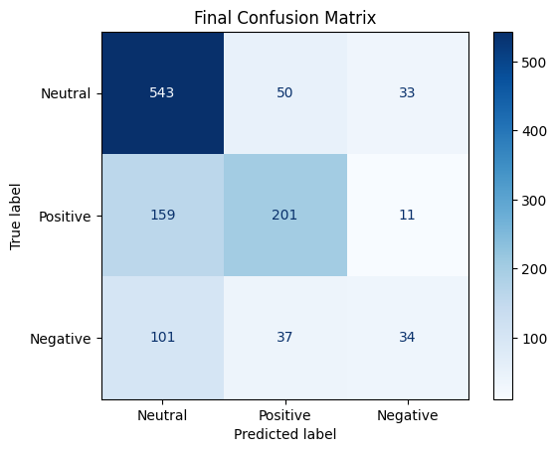
Result Comparison: 3b vs Quaternion
Notes:
Here we show the confusion matrix of the benchmark model and quaternion model. We can notice that there are few differences between them. Each of them perform good on neutral, but bad on positive/negative cases. We can improve our model by using higher amount of parameters later.

Slide 7
Conclusion
(Please fill the conclusion here)

Slide 8
References
(Please fill the references here)

